Slide 1
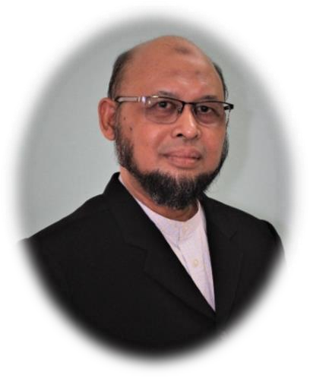
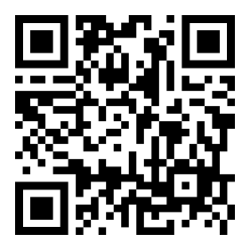
4 REEM CDP
recognised by Suruhanjaya Tenaga
Mr.Ahmad Munawir
HANDS-ON DATA ANALYSIS
25 – 26 September 2023
12 – 13 December 2023
Fee :RM 212 per person (include 6% sst)
(2 days x 4 hours online class)
Who should attend?
Energy Managers / Energy Consultants, Energy Officers, Technical Staff, Facility Owner, Engineers, Energy Professionals, Building Facilities Maintenance Personnel, and Individual who are interested to learn about energy data analysis are encouraged to attend the course.
Let's improve your knowledge and skills in energy data collection and analysis!
Brought to you by
Recognised by
Scan here to register

Slide 2
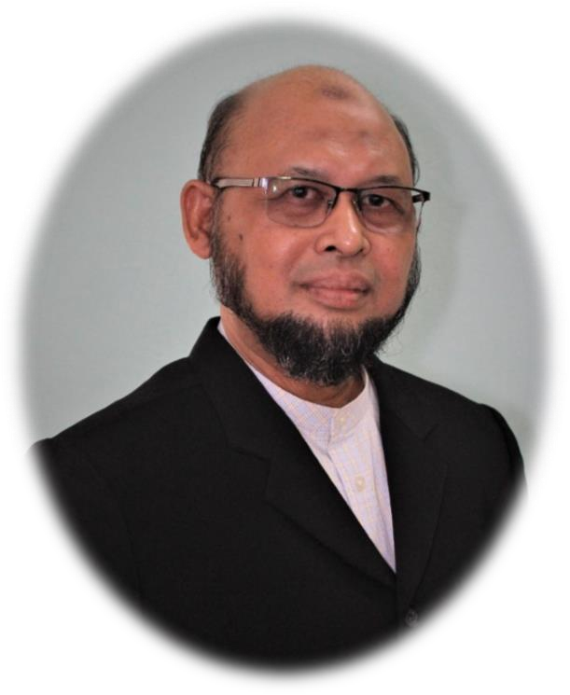
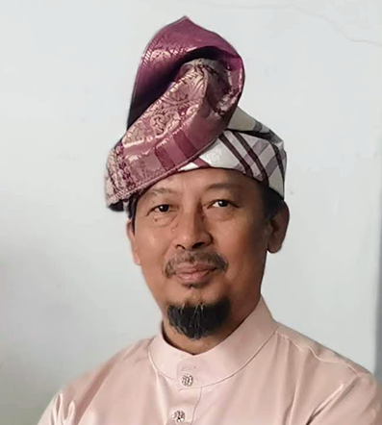
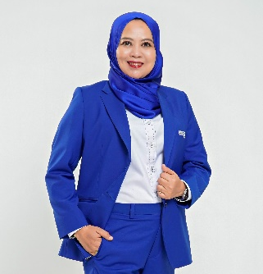
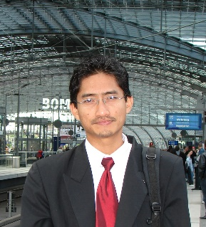
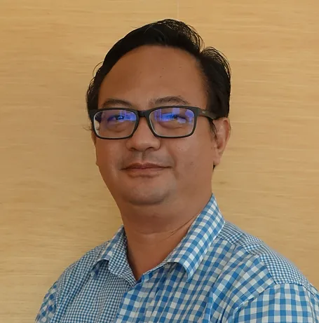
Online - Short Course Program
Meet Our Trainers;
4 REEM CDP
recognised by Suruhanjaya Tenaga
Ahmad Munawir Mohd Hanif
Ir. Al Khairi bin Mohd Daud
Journey to EMGS Certification
Ts. Masilah Bandi
Ir. Haji Ahmad Fatani
31st October–1st November 2023
(2 days x 4 hours online class)
Fee : RM 212 per person (include 6% sst)
Who should attend?
Energy Managers / Energy Consultants, Energy Officers, Technical Staff, Facility Owner, Engineers, Energy Professionals, Building Facilities Maintenance Personnel, and Individual who are interested to learn about how to get prepared for energy management system certification are encouraged to attend the course.
Hishamudin Ibrahim
Brought to you by
Recognised by
Scan here to register

Slide 3
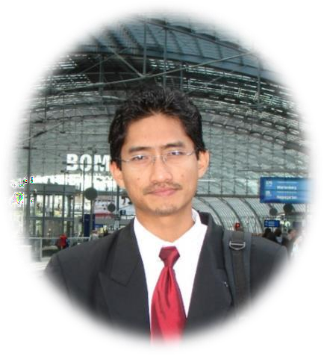
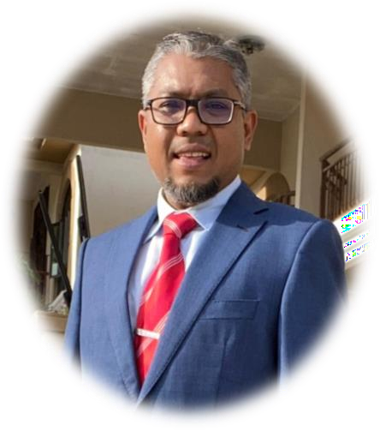
ONLINE SHORT COURSE PROGRAM
BASIC ENERGY AUDIT
Brought to you by
Meet the Expert
23rd August 2023(4 hours online class)
RM106 per person (Include 6% SST)
Hishamuddin Ibrahim
Mr. Hafiz Isa
Ahmad Munawir
Ir. Haji Ahmad Fatani
Who should attend?
Energy Officers, Technical Staff, Facility Owner, Engineers, Energy Professionals, Building Facilities Maintenance Personnel, and Individual who are interested to learn about basic energy audit are encouraged to attend the course.

Slide 4
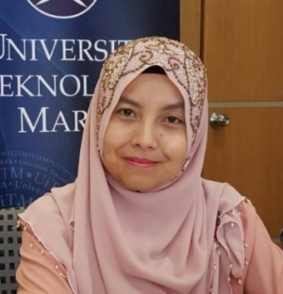
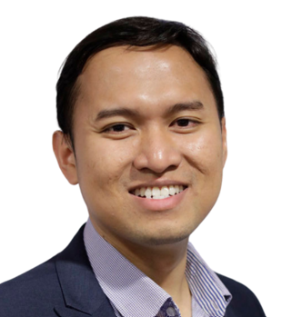
Online Short Course Program BASIC MEASUREMENT AND VERIFICATION (M&V)
Meet Our Expert
4th December 2023(4 hours online class)
RM106 per person (Include 6% sst)
Assoc. Prof. Ir. Ts. Dr. Nofri Yenita Dahlan
Mr. Hafiz Isa
Mr. Hafiz Isa
This program aims to give basic knowledge to the end users and energy service company in measurement and verification activities for energy saving programs. It is also covers the basic fundamental concept of energy savings, available options for Measurement and Verification (M&V) activity and planning.
Ts. Dr. Hassan Mohamed
Who should attend?
Sustainable Improvement Team, Energy Managers / Energy Consultants, Technical Staff, Energy Service Companies’ staff, Energy Management Committee Members, Facility Owners, Architect, Trainers & Lecturers
Brought to you by

